Slide 1

ANALYSIS OF ALGORITHM
WORD SEARCH PUZZLE SOLVER
Backtracking + DFS + Trie – Based Search
Presented to
Dr. Neelam Umbreen

Slide 2
WORD SEARCH PUZZLE

Slide 3
Section - I
Introduction

Slide 4

Problem Overview
A word search problem consists of a 2D grid of characters.
A set of target words is given.
Words may appear
Horizontally, Vertically, Diagonally
Forward or Backward
Goal
Locate each word in the grid
Return its starting position and direction
C
A
T
B
D
F
H
I
J
K
O
L
R
M
P
Q
G
S
V
U
W
X
Y
Z
B
F
N
H
I
J
Sample 5×6 grid (words: CAT, DOG, RUN highlighted)

Slide 5
Problem Statement
8 Search directions
INPUT
OUTPUT
C
A
T
An M×N 2D character grid
A list of K target words
Start cell (row, col)
Direction label (RIGHT, DOWN...)
or NOT FOUND
H
I
J
R
M
P
CONSTRAINTS
8 directions allowed
Cells used once per word path
Words may overlap each other
Horizontal (Left / Right)
Vertical (Up / Down)
Diagonal (4 directions)

Slide 6

Limitations of Brute Force
Brute Force Approach
For each word W, scan every cell in every direction
Compare characters one by one — O(N×M×8×L×K)
Problems:
Repeats search for each word
Huge number of comparisons
Not scalable for large grids
Example — 100×100 grid, 1,000 words, avg length 10:
100 × 100 × 8 × 10 × 1,000 = 800 million comparisons!
Operations (relative scale)
Brute Force
800M ops
Trie + DFS
~144K ops
Trie + DFS Advantage
All K words searched in ONE grid traversal
Prune paths instantly when prefix mismatches
Effective complexity: O(N×M×8×L)

Slide 7
Proposed Solution Overview
🌲 Trie
🔍 DFS
↩ Backtracking
Indexes all K words. Enables O(1)-per-character prefix lookup during DFS.
Explores grid cells from every starting point, following 8 directional edges.
Unmarks visited cells on retreat, ensuring no cell is reused within a single word path.
Core Idea:
Search all words simultaneously
Avoid redundant computations
Key Benefit:
Efficient pruning of invalid paths

Slide 8
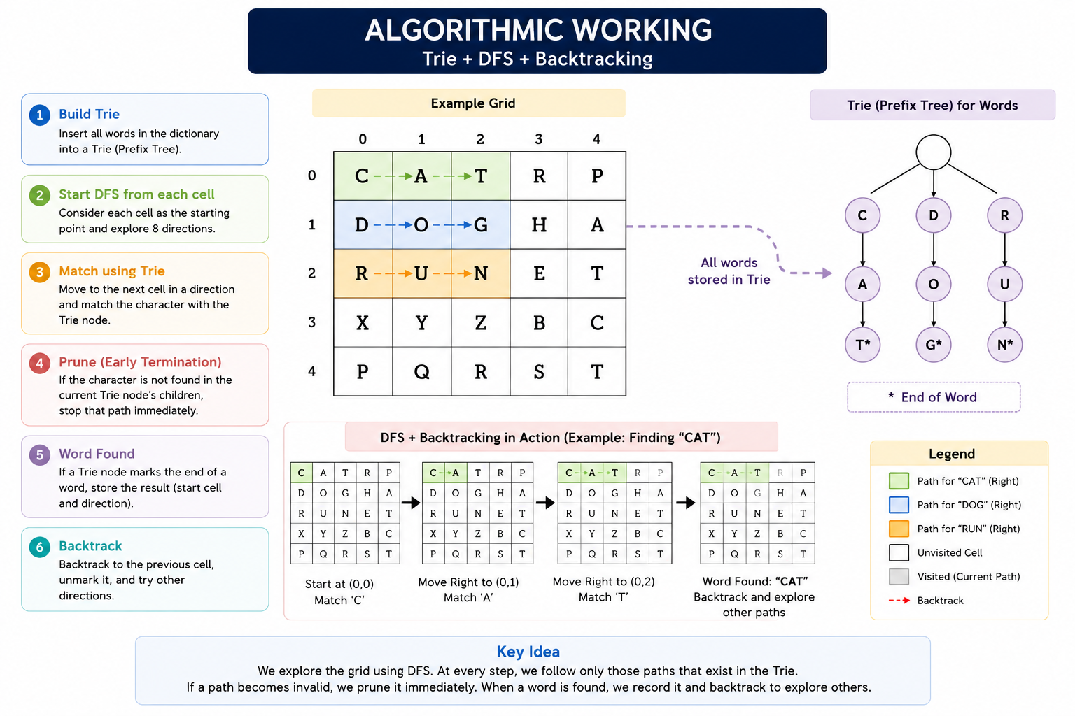

Slide 9
How The Trie (Prefix Trie) Works
Structure
Each node = one character + up to 26 children (A–Z)
End-of-word marker at leaf of each word
Insertion O(L) per word
Letters added one by one; shared prefixes share nodes
Lookup During DFS O(1) per character
At each step check: does this char exist in current Trie node?
No → prune immediately (skip entire direction)
Yes → advance Trie pointer, continue DFS
Key Benefit
All K words checked simultaneously in a single traversal
Prefix Pruning Example
X
X not in Trie root children → PRUNE instantly
C
C found → enter Trie node for C
A
A found → enter Trie node for A
T
T found + end marker → WORD FOUND: CAT

Slide 10
Section - II
Time and Space Complexity

Slide 11
Time and Space Complexity
Time Complexity
Phase | Formula | Explanation
Trie Build | O(K × L) | K words, avg length L
DFS Search | O(N × M × 8 × L) | All cells; 8 dirs; depth L; Trie prunes early
Overall | O(K·L + N·M·8·L) | Trie build + single traversal
Space Complexity
Structure | Space | Notes
Time | O(K × L x 26) | Worst case: unique chars per level
Visited Array | O(N × M) | Boolean per cell; reset on backtrack
Recursion Stack | O(L) | Max depth = longest word

Slide 12
Section - III
Dry Run

Slide 13
Dry Run
Attempt | Direction | Cell | Letter Checked | Grid Letter | Match? | Action
1 | RIGHT | (R2,C1) | U (2nd letter) | M | ✗ NO | PRUNE
2 | LEFT | (R2,C-1) | — | — | ✗ NO | Out of bounds — skip
3 | DOWN | (R3,C0) | U (2nd letter) | V | ✗ NO | PRUNE
4 | UP | (R1,C0) | U (2nd letter) | H | ✗ NO | PRUNE
5 | DOWN-RIGHT | (R3,C1) | U (2nd letter) | U | ✓ YES | Continue DOWN-RIGHT ↘
6 | DOWN-RIGHT | (R4,C2) | N (3rd letter) | N | ✓ YES | All letters matched!
C
A
T
B
D
F
H
I
J
K
O
L
R
M
P
Q
G
S
V
U
W
X
Y
Z
B
F
N
H
I
J

Slide 14
Dry Run
CAT
Start: (R0,C0)
End: (R0,C2)
Dir: RIGHT →
C
A
T
B
D
F
H
I
J
K
O
L
DOG
Start: (R0,C4)
End: (R2,C4)
Dir: DOWN ↓
R
M
P
Q
G
S
V
U
W
X
Y
Z
B
F
N
H
I
J
RUN
Start: (R2,C0)
End: (R4,C2)
Dir: DOWN-RIGHT ↘
All 3 words FOUND ✔ — demonstrating RIGHT, DOWN, and DIAGONAL directions

Slide 15
Section - IV
Alternative Approaches

Slide 16
Alternative Approaches – why not chosen?
Approach | Time Complexity | 8 Directions | Chosen | Reason Not Chosen
Brute Force | O(N·M·8·L·K) | All 8 ✓ | ✗ | Redundant; restarts full scan per word; impractical for large K
KMP per Line | O(K·(N+M)·dim) | Limited | ✗ | Works only on rows/columns; diagonals require special handling
Aho-Corasick | O(N·M + matches) | Limited | ✗ | Theoretically optimal but complex failure-link construction; overkill for this course
Regex Search | Unknown / opaque | Limited | ✗ | No algorithmic insight; unsuitable for 2D traversal or course objectives
Trie + DFS | O(N·M·8·L) | All 8 ✓ | ✓ | Efficient, clear, handles all directions, appropriate complexity for course

Slide 17
Section - V
Implementation
User Manipulation

Slide 18
Implementation
Programming Language:
C++
Used for efficient memory handling and recursion support
Core Components:
Trie (Prefix Tree) for storing words
DFS + Backtracking for grid traversal
Visited array to track used cells
Output Verification
Results are printed to console and also written to an output file: each word followed by its start coordinates and direction, or NOT FOUND.
Anticipated Challenges
Correctly implementing Trie deletion after a word is found (to avoid re-reporting).
Handling diagonal boundary conditions.

Slide 19
Section - VI
Limitations

Slide 20
Limitations of the system
01
Grid Size Cap
02
Single Occurrence
03
Memory Leak
Fixed at 20×20; very large grids need dynamic allocation and iterative DFS.
Only the first match of a word is reported; duplicates in the grid are ignored.
Trie nodes use dynamic memory allocation but are not freed after execution.
04
A–Z Only
05
Stack Overflow Risk
06
No Parallelism
Assumes uppercase English input; other character sets are unsupported.
Deep recursion on huge grids with long words may exceed system stack limits.
Algorithm is sequential; multi-threading could significantly boost large-scale performance.
Future Improvements
Dynamic grid sizes
Multiple occurrence detection

Slide 21

Any Questions?
Thank you for listening!
Presented by
Amina Batool, Irfa Arshad, Nimra Atif, Almarwah K. M. Shaloun Mishal Asim, Hafsa Saghir

